Slide 1

MANGALORE INSTITUTE OF TECHNOLOGY & ENGINEERING
Accredited by NAAC with A+ Grade, An ISO 9001: 2015 Certified Institution(A Unit of Rajalaxmi Education Trust®, Mangalore 575001) Autonomous Institute affiliated to VTU, Belagavi, Approved by AICTE, New Delhi
Badaga Mijar, Moodabidri-574225, Karnataka
Department of CSE (IoT and Cyber Security With Blockchain Technology)
Mini Project Presentation (Phase-3)
" Lung Cancer Detection System "
Project Associates:
Dhaksha Salian
Joshal Fernandes
Under Guidance of:
Ms.Prema Jain Assistant Professor
Dept. of CSE (IoT and Cyber Security With
Blockchain Technology)
- 4MT22IC015
- 4MT22IC019
3. Manisha Suvarna -
4MT22IC025
4MT22IC031
4. Nisha -

Slide 2
TABLE OF CONTENTS
INTRODUCTION
OBJECTIVE
SYSTEM REQUIREMENTS
SYSTEM DESIGN
IMPLEMENTATION
FINAL INTERFACE
CONCLUSION

Slide 3
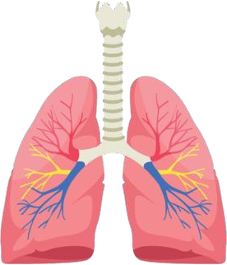
INTRODUCTION
Problem Statement
Traditional diagnostic methods like X-rays and CT scans require expert interpretation, leading to potential human error.

Slide 4
Objective
An automated lung cancer detection system that takes CT scan images as input and predicts whether the condition is benign, malignant, or normal.
A system to predict the presence of lung disease by analyzing patient data.

Slide 5
SYSTEM REQUIREMENTS
pandas: Installed Version: 2.2.3
numpy: Installed Version: 2.1.3
opencv-python: Installed Version: 4.10.0.84
scikit-image: Installed Version: 0.24.0
scikit-learn: Installed Version: 1.5.2
matplotlib: Installed Version: 3.9.2
seaborn: Installed Version: 0.11.2
tqdm: Installed Version: 4.67.0
joblib: Installed Version: 1.4.2
python:Installed Version 3.11.9

Slide 6
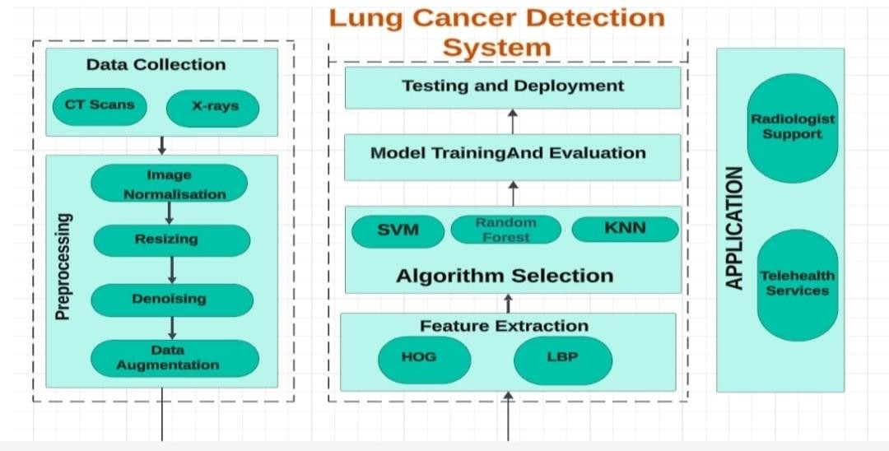
SYSTEM DESIGN

Slide 7
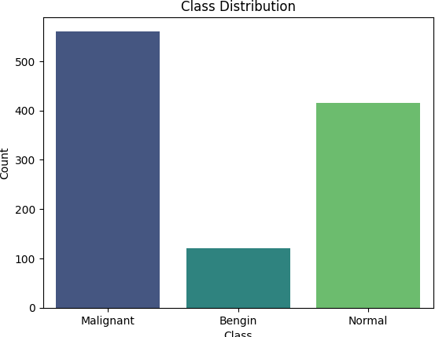
Implementation
Data Import and Organization
Image Preprocessing:
Resizing
Grayscaling
Normalization
3.Feature Extraction:
HOG

Slide 8

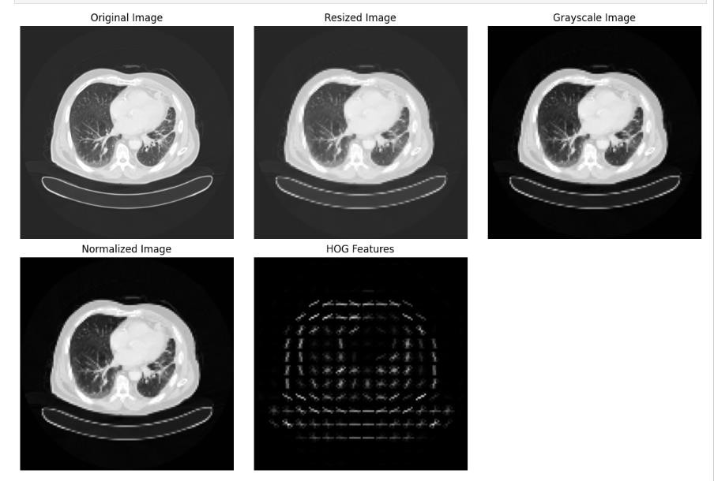
4. Visualization

Slide 9
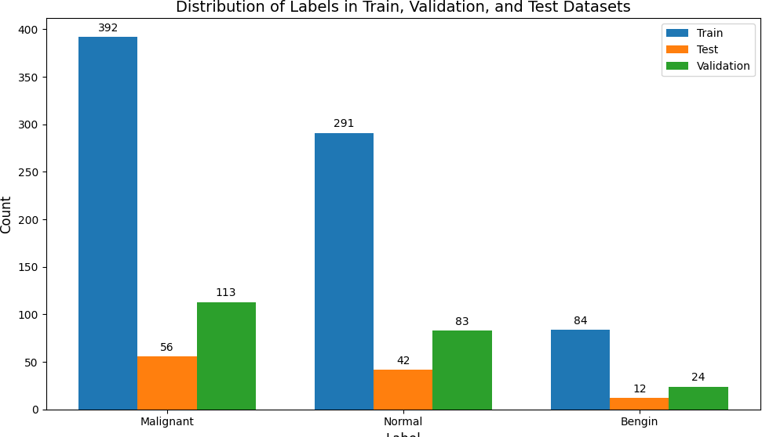
5.Splitting

Slide 10
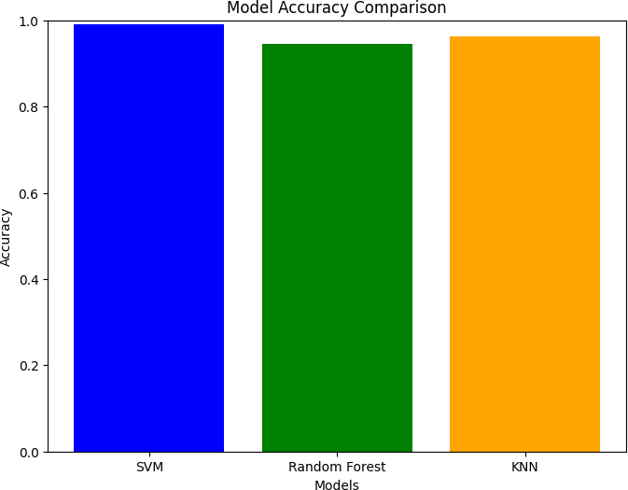
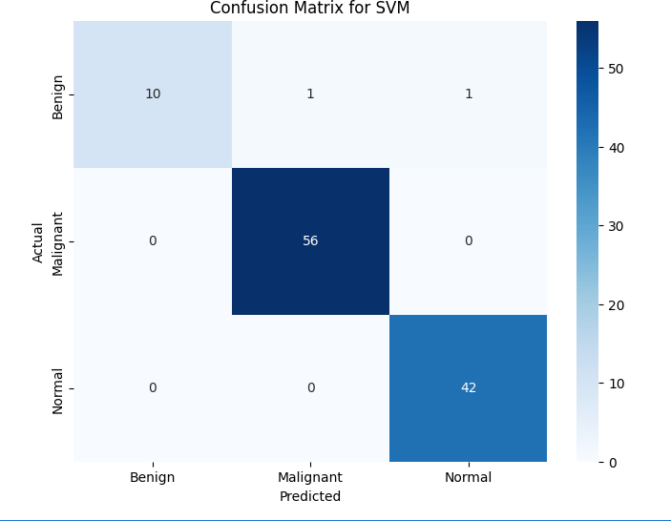
6.Training and Evaluation
For training, we used SVM, Random Forest, and KNN. The accuracy achieved
was 99.09% for SVM, 91.82% for Random Forest, and 94.55% for KNN.
Due to its higher accuracy, SVM was preferred for further implementation.

Slide 11
Implementation Overview: 1.Dataset Information: Input Dataset: 3000 rows, 16 columns
2.Preprocessing Steps:
Missing Value Handling:
Outlier Removal:
Applied Interquartile Range (IQR) method to detect and remove outliers from numerical columns.
Data Encoding:
Encoded categorical variables using Label Encoding for efficient model training.
Feature Scaling:
Scaled numerical features using StandardScaler.
Data Splitting:

Slide 12
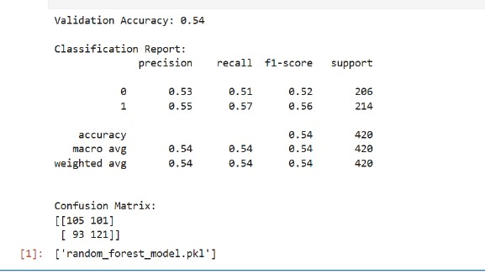
Model Training & Evaluation:
Random Forest Classifier:
Model Evaluation:
Saved the trained model as random_forest_model.pkl

Slide 13
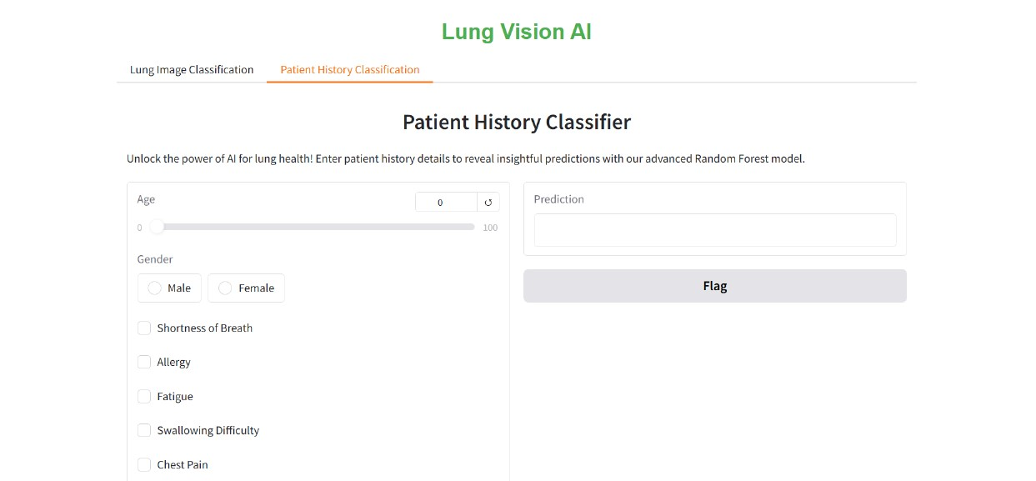
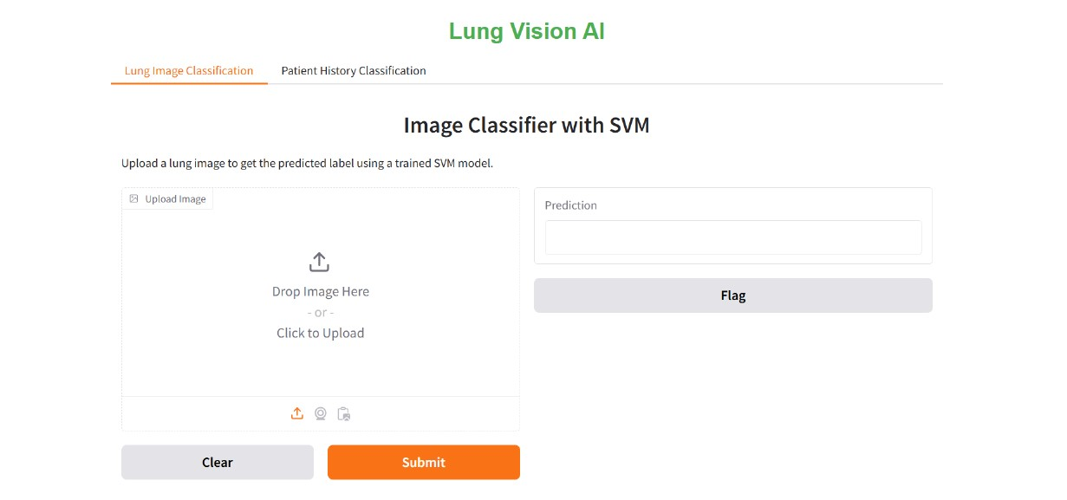
FINAL INTERFACE

Slide 14
CONCLUSION
The lung cancer detection system was successfully implemented, providing two functionalities: (i) classification of CT scan images into benign, malignant, or normal categories, and (ii) prediction based on patient history data.
For future enhancement, the system can leverage deep learning models for improved accuracy and be integrated with a web application to facilitate broader accessibility and real-time usage.

Slide 15

Thank You

